Slide 1
KIDS – Managing Cloud Operations
Project Workflow Presentation
Kairavi Mehta
Meera Udani

Slide 2
What is KIDS?
Knowledge Intensive Database Systems
Helps efficiently manage the large amount of data
Uses intelligence provided to take decisions pertaining to the data
Always evolving to incorporate the new data received

Slide 3
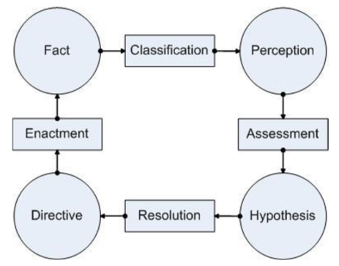
CARE Loop
Development of KIDS is based on the CARE Loop.
The same loop can be viewed from the data perspective (FPHD Loop).

Slide 4
KIDS and Cloud
An ideal cloud operation:
monitors
diagnoses
manages
millions of components in the customer’s as well as the provider’s cloud.
KIDS model is used to make the above stated operations easier to work with.
Also, to provide quicker and more optimized solutions for whenever the SLA is violated
Very important to make sure services provided abide by the SLA

Slide 5
Implementation of the Cloud Scenario
Use the data provided and assess the data given on several factors like wait time, execution time and resources required.
Classify the data by setting the target id ad ‘priority’ assigned to each customer.
From the predictions made by the SVM model for the priorities, an sql query will be fired to find the customers to whom the resources would be allocated
The query produces directives thus developing new facts.

Slide 6
Scenario
We will be considering two tables, CUSTOMER and CUST_REQ_SCHEDULE_FACTORS table.
CLOUD_PERCEPTION: Join these tables on cust_id
PRIORITY_ASSESSMENT: Assess the data setting the target id as ‘priority’.
CLOUD_APPLICATION: The application node for the assessment done having the respective customer id
PRIORITY_HYPOTHESIS: Used for storing the data acquired from the above steps
DIRECTIVE: an SQL query to decide which customer request is fulfilled. Thus developing new facts.
NEW_FACTS: Storing the above optimized results in a table which then becomes new facts.

Slide 7
Implementation
Technologies used
Oracle Database 11g
Oracle Data Miner 11g R2
SQL Developer 4.0.3
For diagrams
Star UML
Data Mining
Data Mining Engine – SVM

Slide 8
Classify based on priority
Facts (Customer Requests)
Asses new priority
Perception(SVM Algorithm uses data in tables to compute new priority)
Resolve by comparing old and new priority
Hypothesis(Assign Resources or not)
Enact based on the decision made
Directive (New Facts)

Slide 9
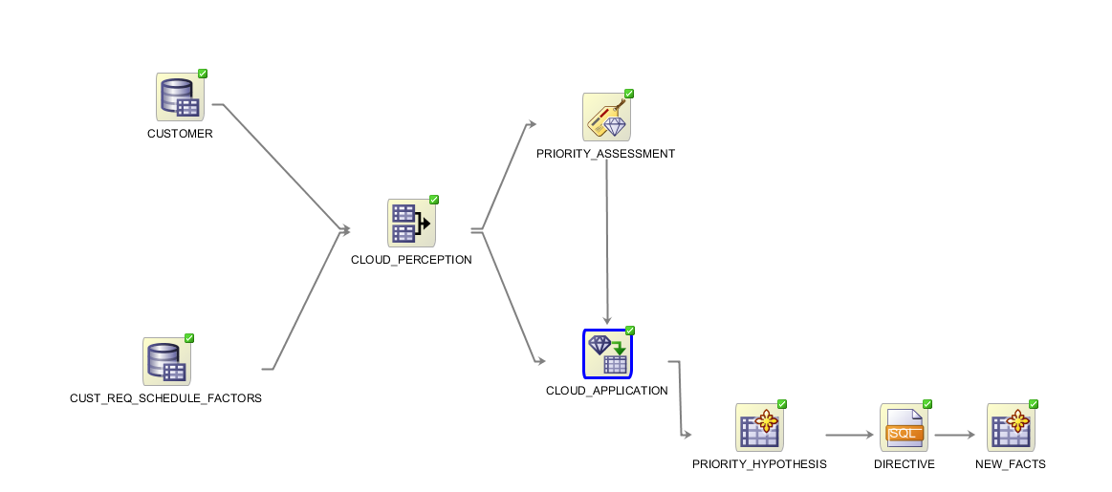
Workflow of the System

Slide 10
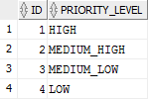
PRIORITY_MASTER
DATA
COLUMNS

Slide 11
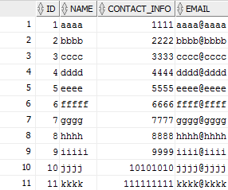

PERSON
DATA
COLUMNS

Slide 12
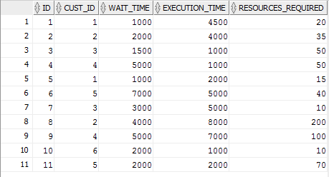
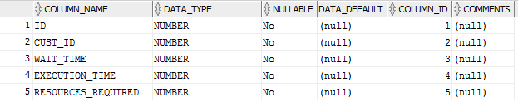
CUST_REQ_SCHEDULE_FACTORS
DATA
COLUMNS

Slide 13
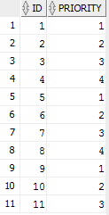

CUSTOMER
DATA
COLUMNS

Slide 14
Future Scope
Extending the CARE loop to include more data
Increasing the complexity of the project

Slide 15
Thank You

